Slide 1
PHOTO JOURNAL: THEODORE ROOSEVELT NATIONAL PARK
Student’s Name
Institutional Affiliations

Slide 2
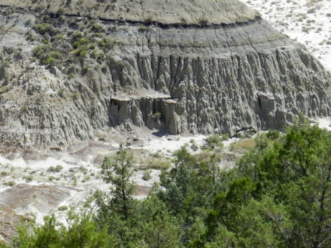
Theodore Roosevelt NP: Geology

Slide 3
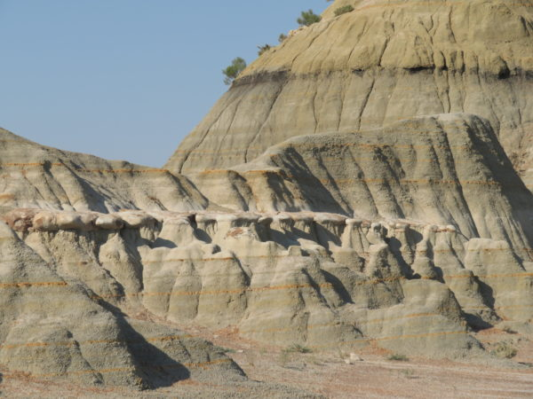
Layers of Sedimentary Rocks
Theodore Roosevelt NP has amazing sedimentary rocks.
Notes:
One thing that one can easily notice in Theodore Roosevelt National Park is the amazing sedimentary rocks formed as a result of the geological processes over 65 million years ago.

Slide 4
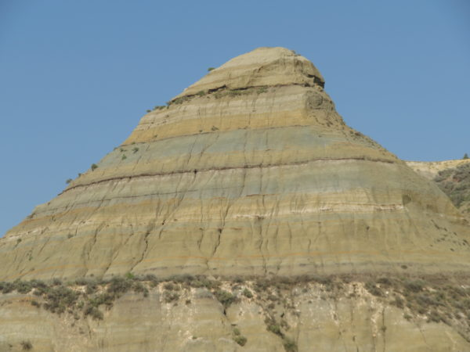
Bentonite
Notes:
This image shows different layers of the sedimentary rocks in Theodore Roosevelt National Park. The blue-green-gray area shows the bentonite, a volcanic ash that was formed over 55 million years ago (The Paths of Discover, 2017).

Slide 5
Lignite layers
Notes:
The black layers on the hillside are the lignite, a soft coal that was formed over 60 million years ago (The Paths of Discovery, 2017).

Slide 6
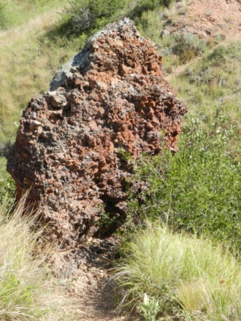
Clinker
Notes:
A clinker is a 12-foot thick coal vein that caught fire in the 1951 as a result of lightning and burned for about 26 years. The above picture shows a clinker that was formed after the fire baked the coal vein.

Slide 7
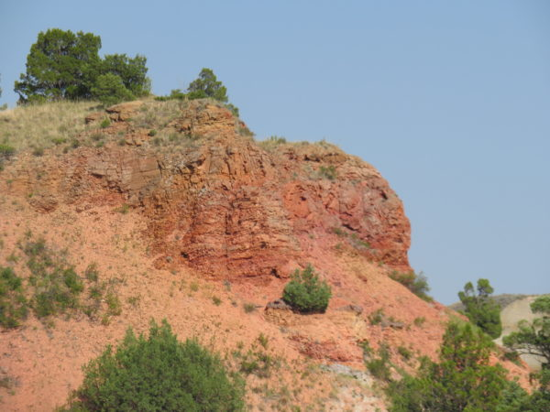
More clinkers
Notes:
The above picture also shows a clinker on the hillside of Roosevelt National Park. As the others, this rock was formed as a result of fire that burned the cola vein.

Slide 8
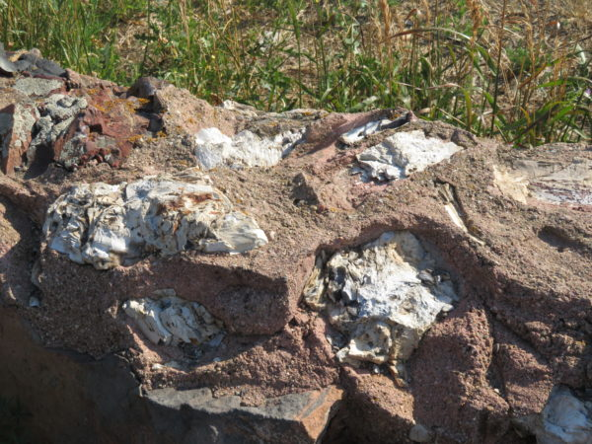
Petrified Trees
Notes:
The above clinker may appear different, but this is because of the Petrified wood particles that surrounds it.

Slide 9
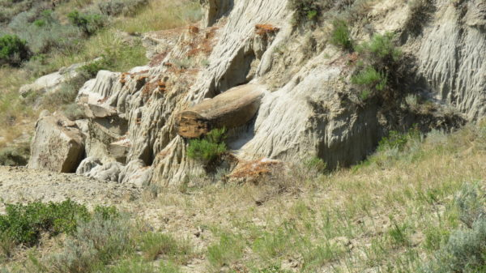
Cannonball Concretions
Notes:
The above picture shows a cannonball concretions that are sometimes formed from the minerals that surround the core in other rocks. The layer that is formed in rounded shapes like cannonballs are stronger and harder than the surrounding rocks (The Paths of Discovery, 2017).

Slide 10
Reference
The Paths of Discovery. (2017). Theodore Roosevelt National Park: Geology. Retrieved from https://thepathsofdiscovery.com/theodore-roosevelt-national-park-geology/

